Slide 1


Retail Sales Forecasting using Neural Networks
PRESENTATION VIDEO LINK (Ctrl + Click)
By:
Bhavish Kumar
Sai Praharsha Devalla

Slide 2
Problem Statement & Project Objective
Highly volatile nature of retail business causes large fluctuations in sales
Poor demand/sales estimation will lead to understocking or overstocking of inventory
Understocking will negatively affect store profits whereas overstocking may result in losses caused by expiration of perishable products
Objective:
Making accurate demand forecasts is crucial for retailers to enhance their inventory planning & competitive pricing
The goal of this project is to predict the weekly sales of Walmart stores and departments at a store & department level by building a multivariate time series forecast model

Slide 3
Data Description
Dataset obtained on Kaggle contains data of 45 Walmart stores located in different regions with each store containing 99 departments
The Time Series Dataset contains 3 CSV files (‘features.csv’, ‘stores.csv’ & ‘train.csv’) that have all the predictor attributes and the target attribute data available across the 3 files
This dataset contains ~421K rows of weekly sales for 99 departments and 45 stores (with 3 store types) across 143 weeks

Slide 4
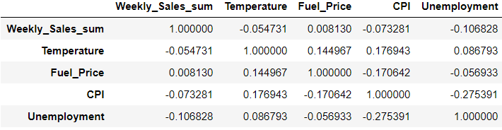
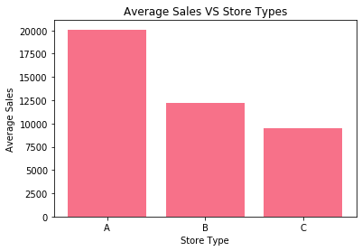
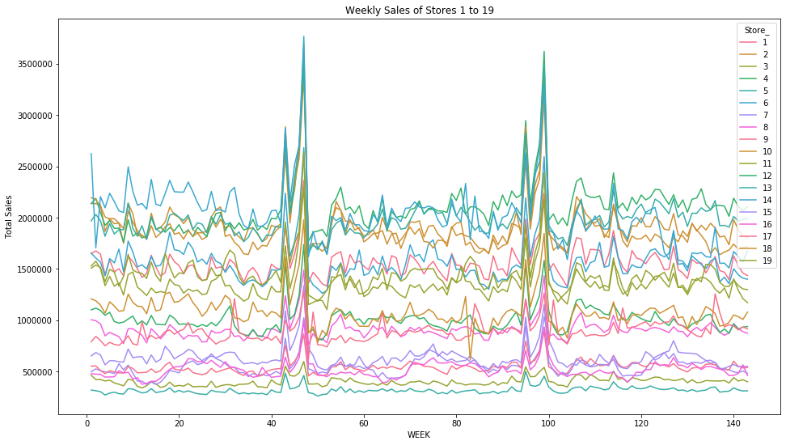
Exploratory Data Analysis
EDA is done to identify interesting trends and patterns in data
The Correlation Matrix shows us the correlation between all the numeric attributes in the dataset
The below bar graph shows that store type can significantly impact sales
The line graph shows a fluctuating seasonal trend across all the 20 stores

Slide 5
Implementation Approach steps
Data Wrangling (Data Cleaning)
Exploratory Data Analysis
Trained the following Forecast Models on Aggregated Store level dataset:
Regular Linear Regression & Random Forest Regression
Feed Forward Neural Network (FFNN) using Plain Backpropagation
Special Recurrent Neural Network (RNN) using Backpropagation Through Time (BPTT)
Long Short Term Memory (LSTMs) & Gated Recurrent Unit (GRU) Networks
Trained the LSTM & GRU Forecast Models on unaggregated store-department level dataset
Compared & Contrasted the evaluation results to draw conclusions

Slide 6
Experiments on Aggregated Store Level Dataset
Store level forecasting had the following 2 experiments in common across all models
Treated each store as a different entity and trained 45 separate models for each of the 45 stores using the corresponding data subset. Note: The moving windows were used on each subset to create lagged value predictor attributes
Used the unified dataset containing all 45 stores to train one single forecast model common for all the stores
But Moving window lag attributes were created separately on each store wise subset and all subsets were unified to create 1 single train data to forecast the model
This was to avoid providing lags of one store to another store

Slide 7
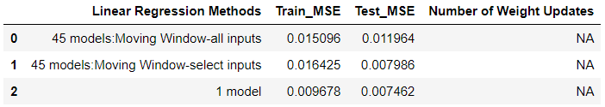
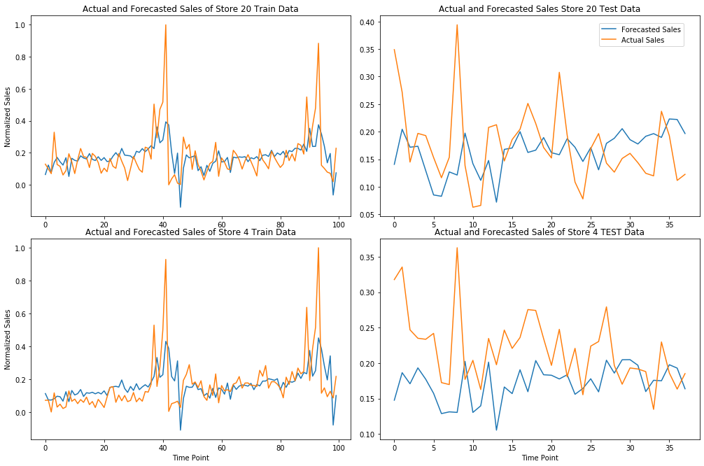
Store Level Forecast with Linear Regression Models
Actual Vs Predicted Sales using approach 1 (45 models: Moving Window-select inputs)

Slide 8
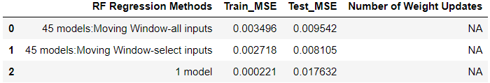
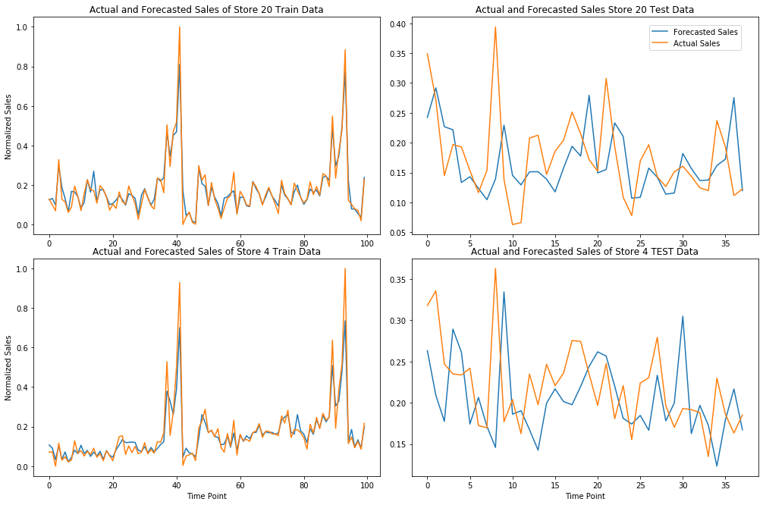
Store Level Forecast with Random Forest Regression Models
Actual Vs Predicted Sales using approach 1 (45 models: Moving Window-select inputs)

Slide 9
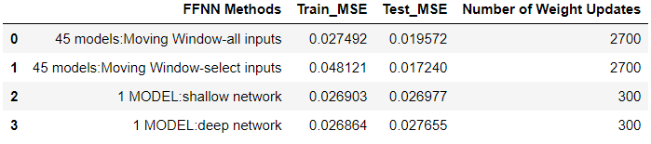
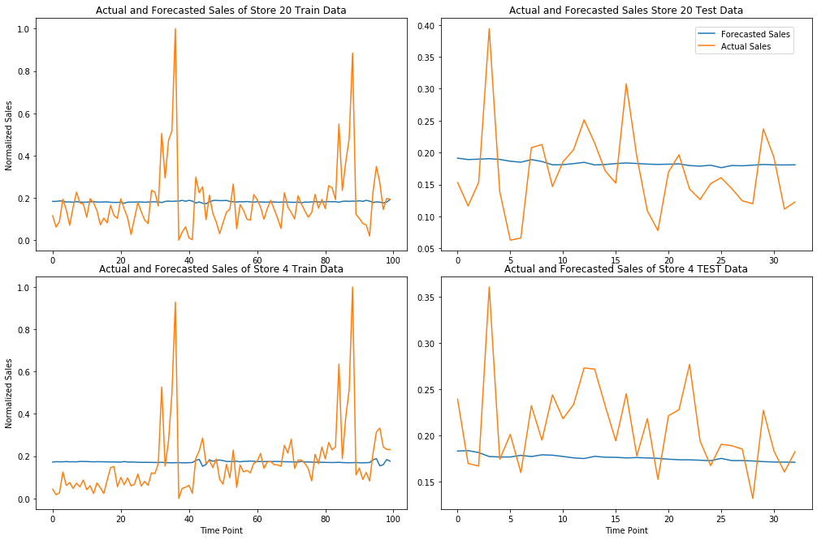
Store Level Forecast with FFNN Models
Actual Vs Predicted Sales using approach 1 (45 models: Moving Window-select inputs)

Slide 10
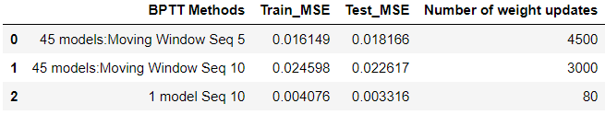
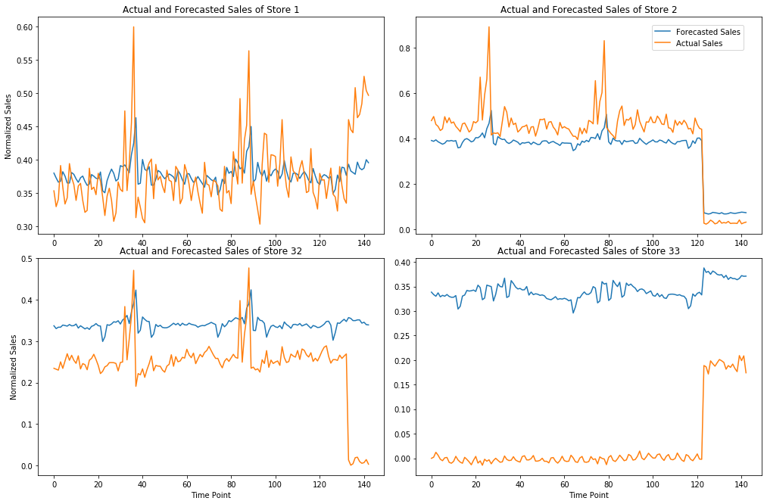
Store Level Forecast with RNN-BPTT Models
Actual Vs Predicted Sales using approach 2 (1 unified model with sequence length 10)

Slide 11
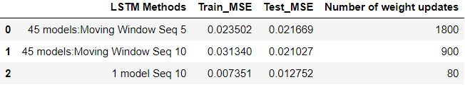
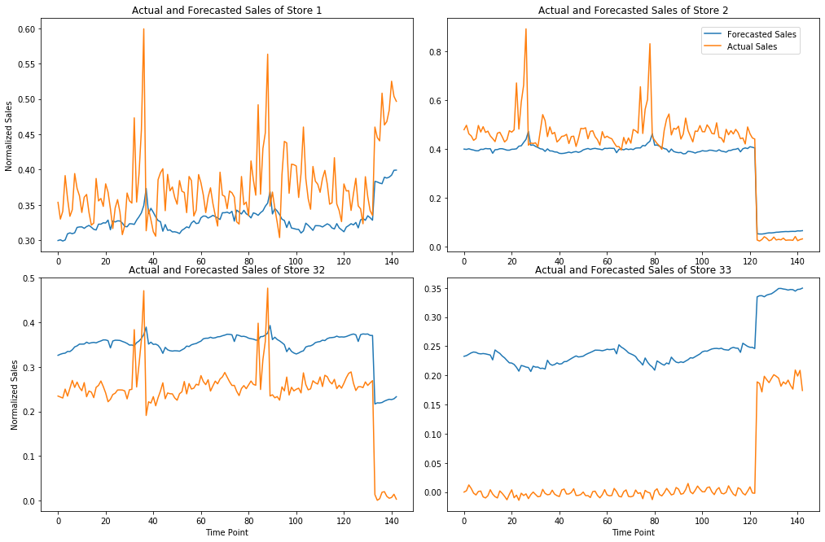
Store Level Forecast with LSTM Models
Actual Vs Predicted Sales using approach 2 (1 unified model with sequence length 10)

Slide 12
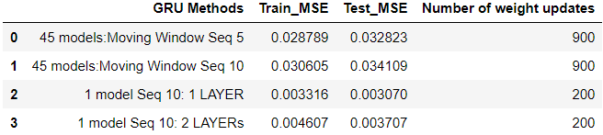
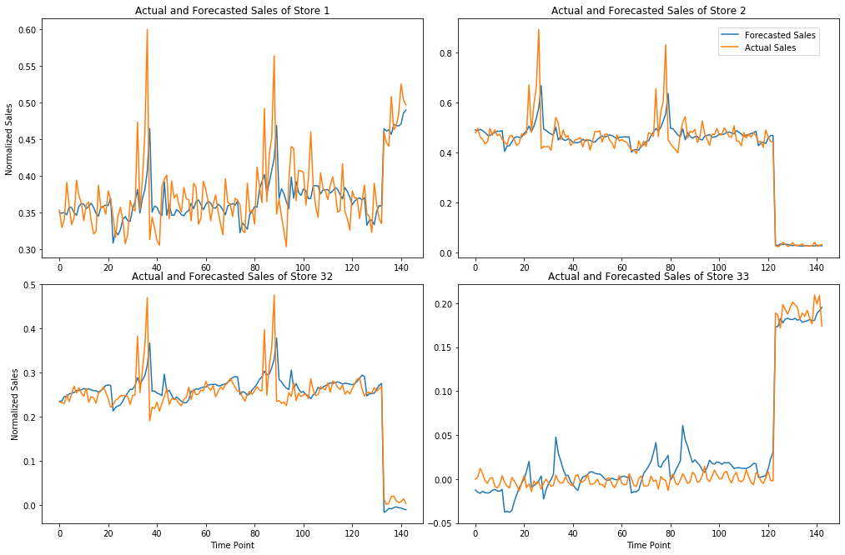
Store Level Forecast with GRU Models
Actual Vs Predicted Sales using approach 2 (1 unified, 1 layer model)

Slide 13
Comparison of the best Store Level Forecast Models
*Mean & Standard Deviation of 30 trials are taken for each model
Model | Mean Train MSE | Std Dev Train MSE | Mean Test MSE | Std Dev Test MSE | Number of Weight Updates
1 unified GRU Model | 0.002265 | 0.000635 | 0.001566 | 0.00119 | 200
1 unified LSTM Model | 0.005828 | 0.002542 | 0.008901 | 0.005926 | 80
1 unified BPTT Model | 0.00638 | 0.002788 | 0.009313 | 0.006148 | 80
1 unified RF Regression Model | 0.000201 | 0.000019 | 0.018051 | 0.000836 | NA
The 1 unified GRU Model has the best results with the lowest Test MSE mean. Also, the computational effort is only marginally higher for GRU model, while the MSE is much better.

Slide 14
Experiments with Department-Store level Forecasts
Used the original unaggregated ‘Store-Department’ level dataset to train single forecast models to predict weekly sales at a Store-Department level
Here only the single model approach was used since it is not feasible to train 45 x 99 = 4,455 models for 4,455 Store-Department subsets
Experimented with LSTM & GRU models which were identified as best performing models for Store level forecasting
Created moving window sliders of sequence length 10 for every store-dept at a time to avoid leaking past data from one dept to another dept. Then we concatenated all the 3D Numpy Arrays to create one Train & Test dataset which was used to create train & test loaders

Slide 15
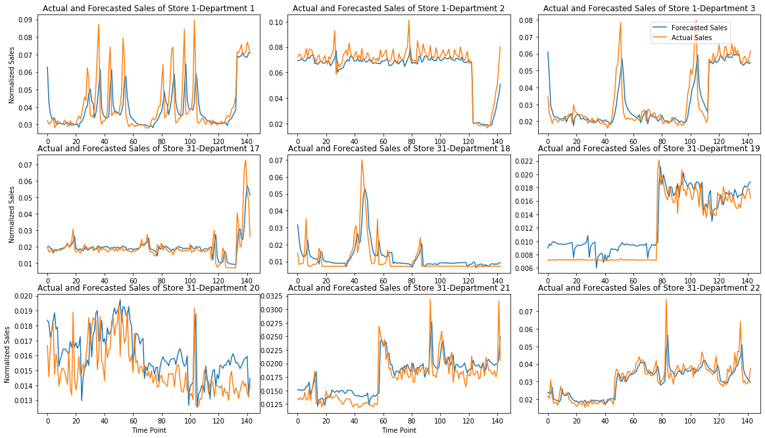
Department-Store level Forecasts with LSTM & GRU models
Actual Vs Predicted Sales using 1-layer single GRU model
Single GRU & LSTM models with 1 layer have the best performance and take minimum computational effort

Slide 16
THANK YOU

